Slide 1




Rock Test
Test automation
that r cks
!
Notes:
PresentationGO.com – The free PowerPoint and Google Slides template library

Slide 2
Testing & Automation – 17/06/2021
1. What is RockTest ?
2. Why RockTest ? (use cases)
3. Where/How can I get RockTest ?
4. Stories
5. Roadmap
6. Q&A
AGENDA
+
+

Slide 3



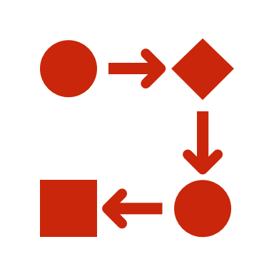

What is Rocktest ?
Super simple scripting engine (YAML syntax)
Allows to automate tests with scenarios
Scenarios are divided into steps
Extensible : based on modules, libraries and functions

Slide 4

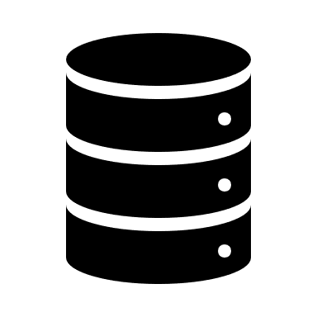
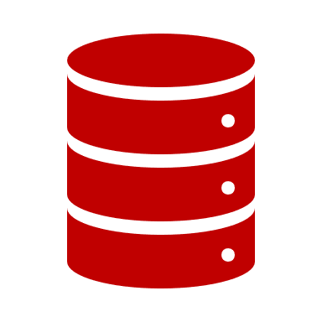





Why RockTest ?
1 tool to test everything
Data transformation
API
Web GUI
Automatic
Easy to learn for testers
Extensible
Legacy
apps
Data transformation
Legacy
data
New data
New app
API

Slide 5



HOW RockTest ?
Free and open source, available on GitHub
https://github.com/rockintest/rocktest/releases/latest
Read the docs on GitHub pages
https://rockintest.github.io/rocktest/
Get the image on the Docker Hub
$ docker pull rockintest/rocktest

Slide 6
A bit of theory
3 ways of testing a fullstack app
A : Full integration test → create and check with the frontend application
B : Mix → create with the app, check with the API
C : Mix (option 2) → create with the app, check in database
C2
C1
A1
A2
JS
HTTP/REST
e.g. SQL
B1
Frontend application
(SPA)
Backend application
Data storage
B2

Slide 7


Demo Time !
https://www.katakoda.com/rocktest

Slide 8




Stories
Hi ! I am Backy.
The greatest backend developer on earth !
I hate repetitive tasks.
Good Afternoon. My name is Chieffy.
I am the product owner.
I am focus on the business.
Yo ! I am Testee.
Cool man. I love to test as much as possible, as often as possible, but I don’t know any programming language.
Hello ! I am frontee.
I am a front end developer. I hate to be blocked by backend issues.
Pictures :

Slide 9


For Frontend dev
Cool frontee !
You can do mocks of Backy’s backend, and use it to develop !
Hello ! I am frontee.
As a front end developer, I want to be able to work on functionalities, before the backend is ready, in order to avoid Backy’s bottlenecks.
Frontee likes :
Mocking API with RockTest
Use SQL persistence in mocks
Notes:
Vérifier que le back est bien sur H2
Lancer le back :
$ rocktest backend.yaml
Frontee
Tour de l’appli de test http://localhost:4200/
Présentation du back avec base H2
Ajouter rocker “Sting”
Ajouter rocker “Santana”
Cas d’erreur (recherche “error”)
Basculer le backend sur MariaDB

Slide 10
For backend dev
Hi ! I am Backy.
As a backend developer, I want to test my API automatically, in order to save time and avoid annoying job.
OK Backy !
To do this, write a scenario doing SQL requests to prepare your data, then HTTP request to call your API and check the results.
Backy loves :
The YAML syntax
Combining SQL and HTTP calls in the same scenario
Notes:
Backy
Scénario:
INSERT INTO rocktest.rock (id,name) VALUES(999,"BobMarley");
get http://localhost:4200/api/heroes?name=BobMarley
Lancer le scenario testbackend.yaml
$ rocktest testbackend.yaml
Lancer le scenario testbackend-fail.yaml
$ rocktest testbackend-fail.yaml
Regarder le résultat de l’API:
$ curl -s http://localhost:8080/api/heroes?name=GunsNRoses | jq

Slide 11
For testers
Nice Testee !
RockTest will save you. Ask Backy to create a RockTest module which will make your scenarios super-simple to write !
Yo ! I am Testee.
As a functional tester, I want to write automatic scenarios with an easy syntax, in order to avoid regressions.
Testee enjoys :
The YAML syntax
The reusable modules in YAML
Notes:
Testee
Se connecter automatiquement à la base:
Ouvrir testee/setup.yaml
2 primitives : createSingerInSQL et checkSingerWithAPI
testee/lib.yaml

Slide 12
For product owners
Good Afternoon. My name is Chieffy.
As a product owner, I want to explain the test cases in my words. I am not a technical man.
Cheffy appreciates :
One tool to test everything
The Web module for e2e tests
Specify the tests using Gherkin language
Hello Chieffy !
Write your test case in Gherkin, then ask the scrum team to write e2e scenarios implementing this specification using RockTest.
Notes:
Chieffie:
> Run angular.yaml
$ rocktest cheffie/angular.yaml
> Run submit.yaml
$ rocktest cheffie/submit.yaml
Test of the front app
Run testfront.yaml
Spec of a feature in Gherkin:

Slide 13
Gherkin with Rocktest
var: username=${gherkin.1}
Feature: Add a new user
Scenario: Add a non existing rocker
Given
And
When
Then
And
sql.request:
params:
request: delete from rock where name = '${username}'
http.post:
params:
url: http://localhost:8080/api/heroes
body: |
{ "name": "${username}" }
a username newRocker
it does not exist
assert.equals :
params:
expected: 201
actual: ${ret}
I add this rocker
I get a success
the rocker is actually created
- sql.request:
params:
request: select count(*) from rock where name = '${username}’
- assert.equals:
params:
expected: 1
actual: ${request.1}
Notes:
Chieffie:
> Run angular.yaml
$ rocktest cheffie/angular.yaml
> Run submit.yaml
$ rocktest cheffie/submit.yaml
Test of the front app
Run testfront.yaml
Spec of a feature in Gherkin:

Slide 14




ALL together
Use RockTest to
!
Turn your web site into an API
HTTP/HTML
HTTP/REST
ESS application
HTTP Mock module
Web module
REST Client
(e.g. Postman)
Notes:
Arrêter le mock
Lancer le serveur ESS

Slide 15

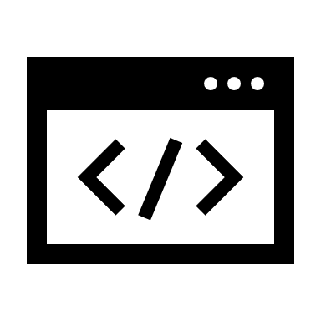



And now ?
RockTest is growing ! Next features :
Kafka module
NoSQL client
Improve Web module (headless browsing, screenshots, video)
Test on Kubernetes
Testsuites
Journey to NoCode ➔ YAML editor
RockTest is yours ! Contribute, make Pull Requests ☺

Slide 16

Questions ?
(speak slowly please, or use chat ☺)

Slide 17

https://github.com/rockintest/rocktest
Notes:
© Copyright PresentationGO.com – The free PowerPoint and Google Slides template library

